Slide 1
School of Computer Science and Engineering
Data Mining and Data Warehouse

Slide 2
Syllabus for module 1
Data Warehouse:
Basic Concepts,
Differences between Operational Database Systems and Data Warehouses
A Multi-tiered Architecture
Data Warehouse Models : Extraction, Transformation and Loading
Metadata Repository :Data Cube and OLAP
Data Warehouse Design and Usage
Data warehouse implementation

Slide 3
Data Warehouse Design and Usage
A Business Analysis Framework for Data Warehouse Design
Competitive advantage
Business productivity
Facilitates customer relationship management
Cost reduction by tracking trends, patterns, and exceptions over long periods in a consistent and reliable manner.

Slide 4
Various Views for a DW design
Top-down view,
Data source view,
Data warehouse view, and
Business query view

Slide 5
Top-down view
The top-down view allows the selection of the relevant information necessary for the data warehouse. This information matches current and future business needs.
Business query view
The business query view is the data view in the data warehouse from the end-user’s viewpoint.

Slide 6
Data source view
The data source view exposes the information being captured, stored, and managed by operational systems.
This information may be documented at various levels of detail and accuracy, from individual data source tables to integrated data source tables.
Data sources are often modeled by traditional data modeling techniques, such as the entity-relationship model or CASE (computer-aided software engineering) tools.

Slide 7
Data warehouse view
The data warehouse view includes fact tables and dimension tables.
It represents the information that is stored inside the data warehouse
Pre-calculated totals and counts,
Information regarding the source
Date, and time of origin, to provide historical context.

Slide 8
Data Warehouse Design Process
A data warehouse can be built using a
Top-down approach
Bottom-up approach or
Combination of both.

Slide 9
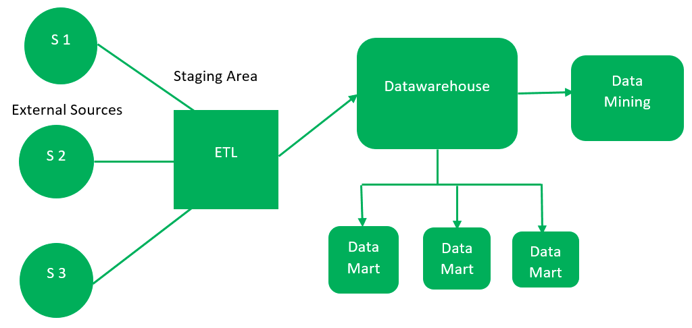
Top-down approach
Top-down approach starts with overall design and planning. It is useful in cases where the technology is mature and well known, and where the business problems that must be solved are clear and well understood.

Slide 10
Essential components of DW
External-Sources The external source is a source from where data is collected irrespective of the type of data. Data can be structured, semi-structured and unstructured as well.
Stage-Area Since the data, extracted from external sources do not follow a particular format, so there is a need to validate this data to load into the data warehouse. For this purpose, it is recommended to use the ETL tool.
E(Extract): Data is extracted from External data sources.
T(Transform): Data is transformed into the standard format.
L(Load): Data is loaded into the data warehouse after transforming it into the standard format.

Slide 11
Essential components of DW contd..
Data-warehouse After cleansing of data, it is stored in the data warehouse as a central repository. It actually stores the metadata and the actual data gets stored in the data marts. Note that the data warehouse stores the data in its purest form in this top-down approach.
Data Marts Data mart is also a part of the storage component. It stores information about a particular function of an organization which is handled by a single authority. There can be as many number of data marts in an organisation depending upon the functions. We can also say that a data mart contains a subset of the data stored in the data warehouse.
Data Mining The practice of analyzing the big data present in a data warehouse is data mining. It is used to find the hidden patterns that are present in the database or in the data warehouse with the help of an algorithm of data mining.

Slide 12
Advantages and Disadvantages of Top-Down Approach
Since the data marts are created from the data warehouse, provides a consistent dimensional view of data marts.
Also, this model is considered the strongest model for business changes. That’s why big organizations prefer to follow this approach.
Creating a data mart from a data warehouse is easy.
The cost, time taken in designing and maintenance is very high.

Slide 13
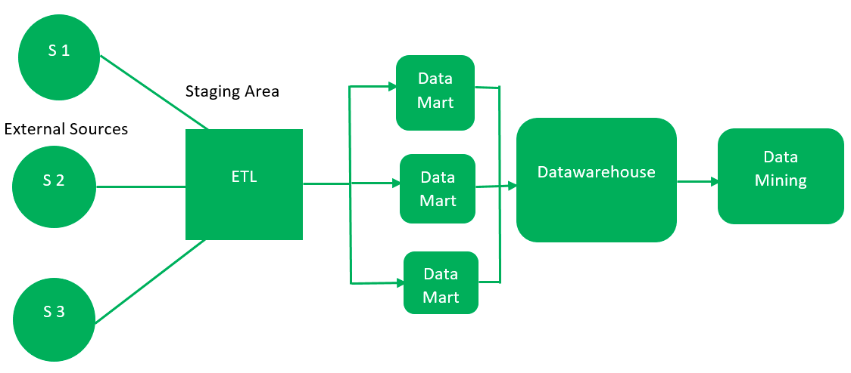
Bottom-up approach
The bottom-up approach starts with experiments and prototypes. This is useful in the early stage of business modeling and technology development. It allows an organization to move

Slide 14
Advantages and Disadvantages of Bottom-up Approach
As the data marts are created first, the reports are quickly generated.
We can accommodate more data marts here and in this way data warehouse can be extended.
Also, the cost and time taken in designing this model is low comparatively.
This model is not strong as top-down approach as dimensional view of data marts is not consistent as it is in the above approach

Slide 15
Combined approach
In the combined approach, an organization can exploit the planned and strategic nature of the top-down approach while retaining the rapid implementation and opportunistic application of the bottom-up approach.

Slide 16
Software Engineering point of view
design and construction of a data warehouse may consist of the following steps:
Planning,
Requirements study,
Problem analysis,
Warehouse design,
Data integration and testing, and finally
Deployment of the data warehouse

Slide 17
Data warehouse design process
Choose a business process to model
Choose the business process grain
Choose the dimensions
Choose the measures

Slide 18
Choose a business process to model
If the business process is organizational and involves multiple complex object collections, which model need to follow:
data warehouse model.
If the process is departmental and focuses on the analysis of one kind of business process, which data model needs to follow:
a data mart model

Slide 19
Choose the business process grain
BPG:
It is the atomic (fundamental) level of data to be represented in the fact table for this process (e.g., transactions, daily snapshots, and so on).
Choose the dimensions
Typical dimensions are time, item, customer, supplier, warehouse, transaction type, and status.
Choose the measures
That will populate each fact table record. Typical measures are numeric additive quantities like dollars sold and units sold.

Slide 20
Goals of data warehouse
Specific,
Achievable, and
Measurable
Time and budget allocations
Subset of the organization that is to be modeled
Number of data sources selected
Number and types of departments to be served

Slide 21
After completion of design and construction of DW
Initial installation,
Roll-out planning,
Training, and
Orientation
Platform upgrades
Maintenance

Slide 22
DW administration includes
Refreshment
Data source synchronization,
Planning for disaster recovery,
Managing access control and security,
Managing data growth,
Managing database performance, and
Data warehouse enhancement and extension.

Slide 23
Applications of DW
Information processing
Analytical processing
Data mining

Slide 24
Information processing
Information processing supports
Querying,
Basic statistical analysis, and
Reporting using crosstabs, tables, charts, or graphs.
A current trend in data warehouse information processing is to construct low-cost web-based accessing tools that will integrate with web browsers.

Slide 25
Analytical processing
Analytical processing supports basic OLAP operations, including slice-and-dice, drill-down, roll-up, and pivoting. It generally operates on historic data in both summarized and detailed forms. The major strength of online analytical processing over information processing is the multidimensional data analysis of data warehouse data.

Slide 26
Data mining
Data mining supports knowledge discovery by finding hidden patterns and associations, constructing analytical models, performing classification and prediction, and presenting the mining results using visualization tools.
“Do OLAP systems perform data mining?
or
Are OLAP systems actually data mining systems?”

Slide 27
Indexing OLAP Data: Bitmap Index and Join Index
bitmap indexing method is popular in OLAP products because it allows quick searching in data cubes. The bitmap index is an alternative representation of the record ID (RID) list. In the bitmap index for a given attribute, there is a distinct bit vector, Bv, for each value v in the attribute’s domain. If a given attribute’s domain consists of n values, then n bits are needed for each entry in the bitmap index (i.e., there are n bit vectors). If the attribute has the value v for a given row in the data table, then the bit representing that value is set to 1 in the corresponding row of the bitmap index. All other bits for that row are set to 0.

Slide 28
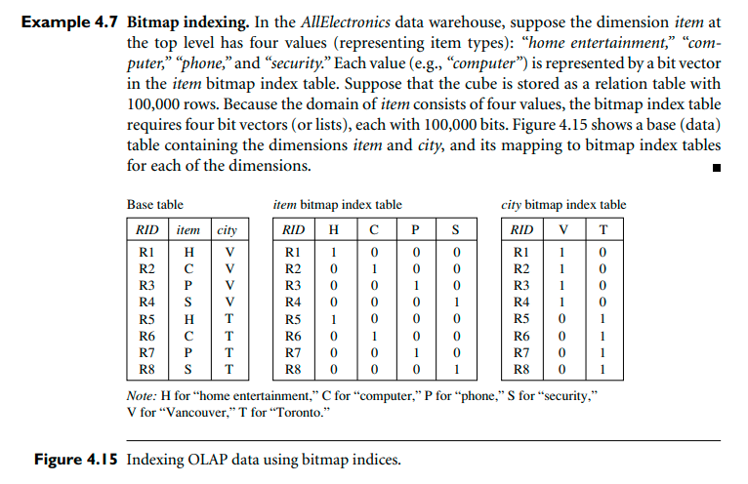
Example

Slide 29
Join indexing
The join indexing method gained popularity from its use in relational database query processing. Traditional indexing maps the value in a given column to a list of rows having that value. In contrast, join indexing registers the joinable rows of two relations from a relational database. For example, if two relations R(RID, A) and S(B, SID) join on the attributes A and B, then the join index record contains the pair (RID, SID), where RID and SID are record identifiers from the R and S relations, respectively. Hence, the join index records can identify joinable tuples without performing costly join operations. Join indexing is especially useful for maintaining the relationship between a foreign key2 and its matching primary keys, from the joinable relation.

Slide 30
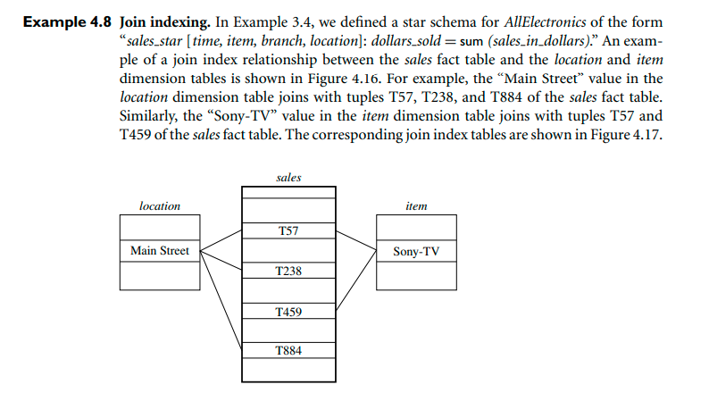
Example

Slide 31
data warehouse design tools
Amazon Redshift is a petabyte-scale data warehouse hosted by Amazon Web Services (AWS). Unlike basic data, Amazon Redshift warehouses is a fully-managed service, which means users are relieved of the architectural and operational challenges that come with setting up and scaling a data warehouse.
AWS (Amazon Web Services)
is one of the prominent leaders of Data Warehousing solutions. Throughout the years, AWS has introduced many services, making it a cost-effective, highly scalable platform. Amazon Redshift is one of the popularly used AWS Data Warehouse Tools used:

Slide 32
Other data warehouse design tools
Amazon Redshift
AWS
Microsoft Azure
Google BigQuery
Snowflake:
Micro Focus Vertica
Amazon DynamoDB
PostgreSQL
Amazon S3
Teradata
Amazon RDS
Maria
Cloudera

Slide 34
Thank You

